Slide 1
Present Progressive

Slide 2
Affirmative | Negative | Interrogative
I am writing now. You are reading a book. He/She/It is eating lunch. We are listening to music. You are working hard. They are discussing their financial problems. | I am not writing now. You are not reading a book. He/She/It is not eating lunch. We are not listening to music. You are not working hard. They are not discussing their financial problems. | Am I writing now? Are you reading a book? Is he/she/it eating lunch? Are we listening to music? Are you working hard? Are they discussing their financial problems?

Slide 3
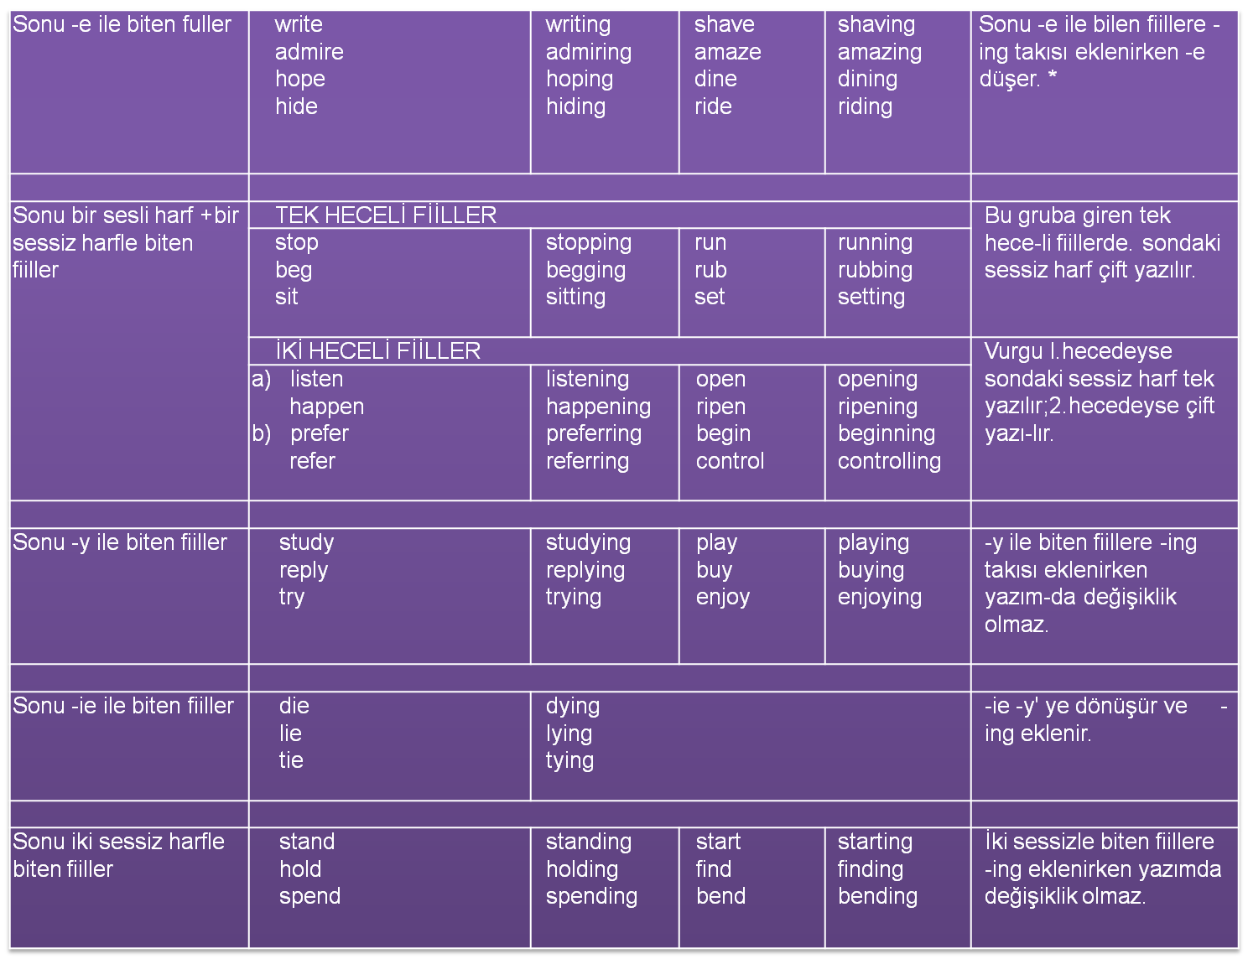

Slide 4
* Sonu -ee biçiminde biten fiiller -Ing takısı alırken -e düşmez: see-seeing, agree-agreeing, free-freeing

Slide 5
Olumsuz soruyu iki şekilde sorabiliriz.
Am I not trying to help you?
Are you not helping your mother?
Is she not studying English?
Are we not leaving for class now?
Are you not watching the film?
Are they not having breakfast?
Or
Aren't I trying to help you?
Aren't you helping your mother?
Isn't she studying English?
Aren't we leaving for class now?
Aren't you watching the film?
Aren't they having breakfast?

Slide 6
USE OF THE PRESENT PROGRESSIVE
a) Bu tense ile temel olarak içinde bulunduğumuz anda yapmakta olduğumuz eylemleri anlatırız. Zamanı pekiştirmek için ise now, right now, at the moment, at present, still gibi zaman zarfları kullanırız.
Mother is in the kitchen now. She is cooking dinner.
Where is your sister?
I think she is writing a letter in her room.
Listen! They are talking about us. Can you hear what they are saying?

Slide 7
USE OF THE PRESENT PROGRESSIVE
b) Konuşmanın geçtiği sırada eylemi yapıyor olmasak bile, o sıralarda yapmakta olduğumuz işleri de bu tense ile anlatırız ve nowadays, these days, this term, this year, this month, this semester, at the moment ("şu sıralar" anlamında) gibi zaman zarfları kullanırız.
How many courses are you taking this term?
I'm taking five courses.
I haven't seen Peter recently. Have you?
No, but I talked to him on the phone last Saturday. He is very busy these days. He is redecorating his house by himself.

Slide 8
USE OF THE PRESENT PROGRESSIVE
c) Değişmekte olan durumları, olayları bu tense ile anlatırız. "Everything is expensive. (Her şey pahalı.)" cümlesi, fiyatların o anki durumunu anlatır. Fakat, "Everything is getting more and more expensive. (Her şey gittikçe pahalılaşıyor.)" ifadesi, fiyatların sürekli değiştiğini, yükseldiğini gösterir.
It is cold. (Hava soğuk.)
It is getting colder. (Hava gittikçe soğuyor.)
The economic situation in Turkey is very bad. (Türkiye'nin ekonomik durumu çok kötü.) The economic situation in Turkey is getting worse. (Türkiye'nin ekonomik durumu gittikçe kötüleşiyor.)

Slide 9
USE OF THE PRESENT PROGRESSIVE
d) Bu tense'i, "always" ve aynı anlamı veren benzer zarflarla (perpetually, repeatedly, continually, forever, constantly) kullanarak, tekrarlanan eylemleri vurgulayabilir, ya da yakınma ve hoşnutsuzluk ifade edebiliriz.
I'm always hearing strange things about him.
You're always making mistakes. Be more careful.
You're constantly smoking at the dinner table. Can't you go somewhere else?

Slide 10
USE OF THE PRESENT PROGRESSIVE
He is leaving Istanbul after two day.
Örneklerde görüldüğü gibi, cümle yapı olarak şimdiki zamana, anlam olarak ise gelecek zamana aittir. Aynı kullanım Türkçe'de de vardır ve bu cümleleri Türkçe'ye, gelecek zaman ya da şimdiki zaman yapısında çevirmemiz mümkündür. Son örneği şu şekilde çevirebiliriz:
İki gün sonra İstanbul'dan ayrılıyor. (İki gün sonra İstanbul'dan ayrılacak.)

Slide 11
ı. | DÜŞÜNMEYE İLİŞKİN FULLER (MENTAL STATE) think * realize understand suppose notice feel believe recognize doubt imagine know remember | forget mean want need prefer
2. | DUYGU BELİKTEN FULLER (EMOTIONAL STATE) love dislike loathe hate appreciate fear like detest envy | mind wish care forgive desire
3. | SAHİPLİK BİLDİREN FiiLLER (POSSESSION) possess have * own | belong
4. | DUYU FİİLLERİ (SENSE PERCEPTIONS) see * hear smell* | taste * feel *
5. | DİĞER DURUM BİLDİREN FULLER look * owe be * seem cost exist appear* weigh * advise | promise consist of refuse include contain sound
* Yanında yıldız olan fiiller, farklı bir anlam taşıdıkları zaman, sürerlik bildiren tense'lerle kullanılabilirler.

Slide 12
NONPROGRESSIVE or PROGRESSIVE
think "sanmak, zannetmek'
I think she is a student.
I think they will visit us next week.
think "düşünmek"
I'm thinking about going abroad next year. She is thinking about her family.

Slide 13
NONPROGRESSIVE or PROGRESSIVE
see "görmek'
Right now, I'm looking out of the window, and I see lots of people in the street.
see "görüşmek"
The doctor is seeing his patient now. The manager is seeing the applicant now.

Slide 14
NONPROGRESSIVE or PROGRESSIVE
smell "kokmak"
This perfume smells very nice.
These flowers smell awful.
taste (bir nesnenin tadından söz ediyorsak)
This soup tastes awful. I can't eat it. (Çorbanın tadı berbat.) The dinner looks bad but tastes delicious. (Yemeğin görüntüsü kötü ama tadı güzel.)
smell "koklamak'
Look! Mother is smelling the flowers. Why are you smelling the milk?
taste "tadına bakmak'
Look! The judges are tasting my dish right now. I can't wait to hear the result.

Slide 15
NONPROGRESSIVE or PROGRESSIVE
feel (bir nesnenin bize verdiği duyguyu ifade ederken; "sezinlemek, ummak" anlamında)
This pillow feels very hard. (This pillow is very hard./Bu yastık çok sert.) I feel (that) something bad will happen. (Kötü bir şeylerin olacağını hissediyorum.)
feel "hissetmek"
I feel better now./I'm feeling better now. (Şimdi kendimi daha iyi hissediyorum.)

Slide 16
NONPROGRESSIVE or PROGRESSIVE
look "gibi görünmek'
You look ill. You'd better go home.
That ladder doesn't look safe.
appear "gibi görünmek"
The teacher appears to be in a bad mood today. She appears to be bored with the film.
look "bakmak'
Why are you looking out of the window?
appear "(ortaya) çıkmak'
The comedian is appearing nightly at the Broken Door club.

Slide 17
NONPROGRESSIVE or PROGRESSIVE
weigh (bir nesnenin ağırlığını söylerken)
The baby weighs six kilograms.
weigh "tartmak"
The butcher is weighing the meat now.

Slide 18
be (genel bir durum ifade ederken am, is, are)
You are very rude. (Çok kabasın.) (Kişinin genelde kaba biri olduğunu belirtir.)
be (konuşma anında bir değişimi ifade ederken am/is/are being)
You are being rude. (Kabalaşıyorsun.) (Kişinin konuşma sırasında kaba davrandığını belirtir. "Kabalık" kişinin genel bir özelliği olmayabilir.)

Slide 19
NONPROGRESSIVE or PROGRESSIVE
have (sahiplik bildiriyorsa)
I don't have much money now. She has two brothers.
have (eylem bildiriyorsa)
She is having breakfast now.
Father can't come to the phone. He is having a shower right now.

Slide 20
Use either the Simple Present or the Present Progressive of the verbs given in parentheses.
are
doing
1. A: What ……….. you (do) ………… here in the kitchen?
B: I (taste) …………………. the soup to see if it (have) …………. enough salt.
2. These cultivated roses (look) …………… so beautiful, but they (not smell) …………….….. at all.
am tasting
has
look
don’t smell

Slide 21
Do
know
3. A: ………… you (know) ………….. the woman who (talk) ………………. to Peter over there?
B: No, I (not recognize) ………..…………….. her, but I (suppose) ……………… that she is his guest from Germany.
4. My brother (weigh) ……………. about 70 kg, but he (seem) ……………… heavier because he (always, wear) ……………………. such bulky clothes.
is talking
don’t recognize
suppose
weighs
seems
always wears

Slide 22
are rising
5. Prices (rise) ……………… so quickly nowadays that we (even, consider) ……………………….………. selling our car just to keep up.
6. Mum (weigh) …………..………… herself again because she (try) ……..……… to lose weight in time for her holiday next month.
are even considering
is weighing
is trying

Slide 23
are arriving
7. Our guests (arrive) ………..……..…. shortly, and Sarah (still, wrap) ……………..………... the presents.
8. Jack is lucky. He (listen) …………………… to Brahms's music live at the Albert Hall at this very moment while we (sit) …………..…….. here in the office listening to the BBC orchestra on the radio.
is still wrapping
is listening
are sitting

Slide 24
9. This powdered pudding is strawberry flavour, but actually, it (not taste) ……….………….. fruity at all.
10. The Earth (get) ………..………. warmer and warmer, which (raise) ………………. the sea-level.
doesn’t taste
is getting
is raising

Slide 25
11. What lovely quality this baby outfit is! It (feel) …………. nice and thick.
12. A: You (look) ……………. very worried. I (hope) …………. nothing bad has happened!
B: Well, I've broken Grandma's favourite mug, and now I (think) ……………...….. about how to explain it to her.
feels
look
hope
am thinking

Slide 26
13. Don't worry about your dog. The vet (feel) …….....……. his legs to check that nothing is broken.
14. A snake's skin (look) ………….. slimy, but it (not, feel) …………......…. slimy at all.
14. The conditions these Afghan refugees (endure) ………........……… in these troubled times are appalling.
is feeling
looks
doesn’t feel
are enduring

Slide 27
is seeing
15. At the moment, the judge (see) …..…………. both the Defendant's lawyer and the Claimant's lawyer privately in his chamber.
16. A: ……..you (think) …………. you (have) ………….. any chance of winning this chess match?
B: Yes, I (see) ………… a number of good moves that I can make from this position.
Do think
have
see

